Slide 1

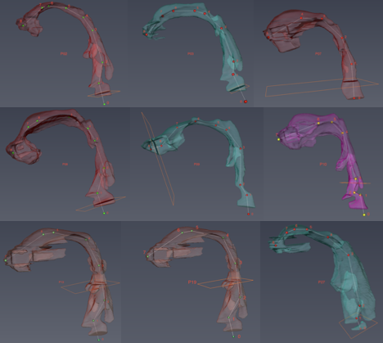
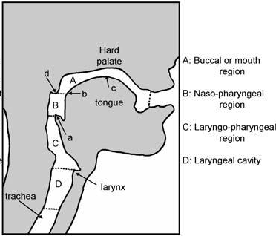
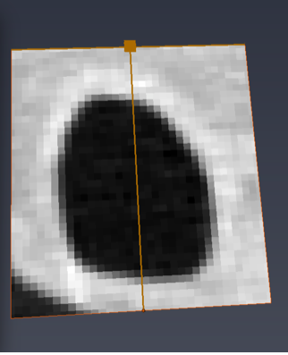

Variability in CT-based upper airway morphology and its effect of deposition of inhaled particles Theo Jan¹, Andrew P. Kuprat², Sean Colby², Richard A. Corley³, & Chantal Darquenne¹ University of California, San Diego, CA¹, Pacific Northwest Natl Lab, Richland, WA², Greek Creek Toxicokinetics Consulting, LLC, Boise, ID^{3,}
BACKGROUND
RESULTS AND DISCUSSION
Delivery of therapeutic drugs by aerosol inhalation is a well-established means for the treatment of pulmonary diseases.
While lung deposition is often used as a surrogate marker for therapeutic effects, response to therapy highly depends upon the regional distribution of deposited drugs.
Deposition in the throat is a major source of variability in lung deposition and represents a major obstacle to aerosol delivery to the intrathoracic airways. Thus, deposition in the throat is a major factor affecting therapeutic effects.
Upper Airway Geometry in All Subjects
OBJECTIVES
To determine the intersubject variability of upper airway (UA) geometry and its effect on upper airway deposition.
METHODS
Human 3D Geometry without distal MPPD models
Upper airway geometry
We used CT scans obtained in 4 healthy subjects (FEV₁ > 80%pred) and 5 mild-to-moderate COPD patients (FEV₁ = 56-83 %pred) at the end of a 1 liter inhalation .
Upper airway geometries were determined using Amira (v6.5) and were based on an intensity threshold (-.-.-, Figure 1) based on the intensity in the center of the airway (---) and that in the surrounding tissues (...).
The same threshold was used for all subjects.
Uncoupled model under-estimates concentrations in 3D domain during expiration since zero concentration assumed at distal ends of 3D model during exhalation.
Tissues
Tissues
Threshold
Airway
Particle mass transferred between 3D domain and distal 1D at each of 117 distal outlets
Convection-diffusion equation used in 3D domain for small (10 nm) particles
Multiple Path Particle Deposition model (MPPD) used in 1-D domains (Anjilvel, S. and B. Asgharian. Fundamental and Applied Toxicology, 1995. 28:41-50; Asgharian, B., et al. Aerosol Science and Technology, 2001. 34:332-339).
Airflow & particle mass conserved between models
Figure 1
Figure 2 – PLACE HOLDER
The upper airway was divided in four regions of interests (ROI, Figure 2) bounded by anatomical landmarks: tip of uvula, tip of epiglottis, vocal cords and the fifth intervertebral disc.
For each subject, the UA volume and the average and minimum cross-sectional area of each region were calculated.
Intersubject variability was assessed by the coefficient of variation CoV (SD/mean)
Upper airway deposition
Deposition (DE_{UA}) was predicted based on a characteristic diameter (d_{c}) defined as the square root of the average cross-section of the laryngeal-pharynx region as follows:
DE_{UA} = [1-1/(1.51 x 10⁵(Stk ^{3.03}Re ^{0.25})+10] x 100
where
$Re=\frac{4ρ_{air}Q}{πμd_{c}}$ and $Stk=\frac{2ρ_{p}d_{p}^{2}QC_{c}}{9μπd_{c}^{3}}$
µ , 𝜌_{air} are the dynamic viscosity and density of air; d_{p} , 𝜌_{p}, the particle diameter and density; Q, the flow rate; and C_{c}, the Cunningham correction factor (Ann. Biomed. Eng., 41:979, 2013).
CONCLUSIONS AND NEXT STEPS
Bi-directionally coupled 3D-1D model predicts ventilation heterogeneities & aerosol transport & deposition profiles not predicted by 3D or 1D models alone.
Incorporation of 1D MPPD model critical for accurate 3D-CFD simulations of particle fate during exhalation.
Next steps:
Develop more efficient Eulerian & Lagrangian transient 3D simulation approaches for wide range particle sizes.
Evaluate model performance against our rich database of multi-modal 3D imaging and aerosol deposition measurements in human volunteers that include both healthy and COPD cohorts.
Funded by 1U01ES028669 from the NIEHS at the NIH

